Slide 1
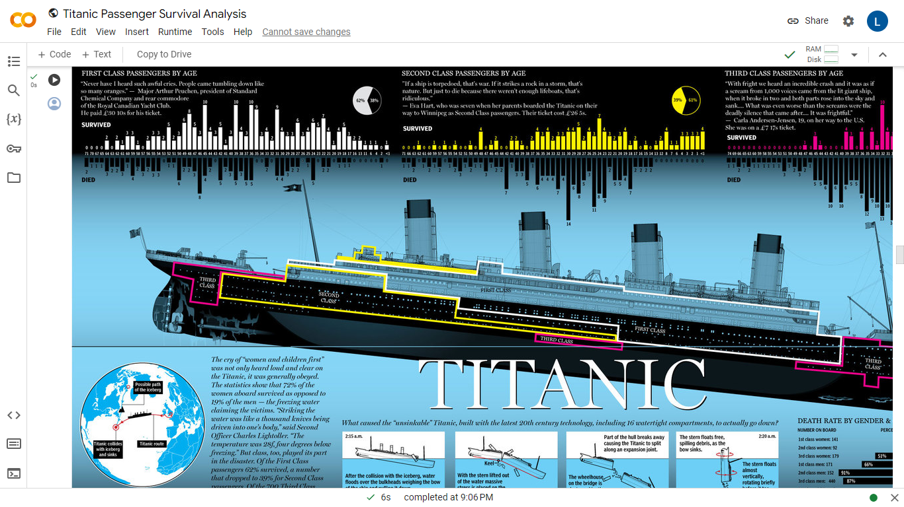
TITANIC SURVIVAL ANALYSIS
A Micro Project Presentation
STUDENT NAME: LAKSHMI NARASIMMAN.P
REG NO : 99220040297
DEPARTMENT : CSE
STERAM : DATA ANALYTICS
YEAR : 2

Slide 2
Abstract
This data science project delves into the tragic sinking of the RMS Titanic, employing advanced analytical techniques to uncover patterns and predictors influencing passenger survival. Leveraging a comprehensive dataset encompassing passenger information, socio-economic factors, and survival outcomes, our study aims to contribute valuable insights into the dynamics of survival during the disaster.
The study evaluates the impact of various factors on survival, including age, gender, class, and family size. Additionally, a detailed analysis of missing data is conducted, and imputation strategies are employed to address gaps in the dataset. The project utilizes cross-validation techniques to assess the robustness of the predictive models and optimize their performance.
Furthermore, visualizations are incorporated to provide a clear and intuitive representation of the relationships between different variables and survival outcomes. This enhances the interpretability of the findings and facilitates communication of the results to a broader audience.

Slide 3
INTRODUCTION
The sinking of the RMS Titanic in 1912 remains one of the most infamous maritime disasters in history, capturing the imagination of generations and prompting a myriad of inquiries into the factors that determined passenger survival. This data science project endeavors to unravel the mysteries surrounding the Titanic tragedy by employing advanced analytical techniques to scrutinize and model the survival outcomes of its passengers. The rich dataset at our disposal, comprising detailed information about the passengers, their socio-economic backgrounds, and their ultimate fates, presents a unique opportunity to apply data science methodologies in understanding the patterns and predictors of survival.
The Titanic dataset is a classic in the realm of data science, offering a glimpse into the demographics and circumstances of those on board. Leveraging this dataset, our analysis seeks to address fundamental questions such as: What role did age, gender, and socio-economic status play in determining survival rates? Were certain passenger classes more likely to survive, and how did family dynamics influence the chances of making it through this catastrophic event? By employing sophisticated statistical models and machine learning algorithms, we aim to derive actionable insights that contribute not only to the understanding of historical events but also to the broader field of data science.

Slide 4
Objective
The primary objective of the Titanic survival analysis project is to investigate and uncover the determinants of passenger survival during the historic maritime disaster. By delving into the dataset, the project seeks to identify patterns and correlations among various factors such as age, gender, class, fare, and embarkation point in relation to survival outcomes.
Through meticulous data exploration, the project aims to gain a nuanced understanding of the distribution of features and their impact on the likelihood of survival. Data preprocessing steps involve handling missing values, converting categorical variables, and creating new features to enhance the quality of input for subsequent analysis.
Utilizing statistical analysis and machine learning techniques, the project endeavors to build predictive models that can accurately discern survival probabilities. This involves training models on a subset of the dataset, assessing their performance through metrics such as accuracy and precision, and fine-tuning their parameters for optimal results.

Slide 5
Literature Survey
Survival Analysis in Historical Events:
Reference: Piantadosi, S. (1997). Clinical Trials: A Methodologic Perspective. Wiley.
Summary: Explore survival analysis methodologies applied in historical events and disasters. Understand the challenges and nuances of modeling survival in such contexts.
Titanic-Specific Studies:
Reference: Thomas, M. (2012). Titanic: Machine Learning from Disaster. Kaggle Competition.
Summary: Investigate Kaggle competitions and related projects that have applied machine learning to the Titanic dataset. Understand the features and models used, as well as the lessons learned.
Feature Engineering and Model Selection:
Reference: Kuhn, M., & Johnson, K. (2013). Applied Predictive Modeling. Springer.
Summary: Explore literature on feature engineering and model selection in predictive modeling. Understand how different features impact model performance and the importance of choosing appropriate algorithms.
Data Imputation Techniques:
Reference: Little, R. J. A., & Rubin, D. B. (2002). Statistical Analysis with Missing Data. Wiley.
Summary: Investigate techniques for handling missing data. Understand the implications of missing values and explore best practices for imputation.
Machine Learning Interpretability:
Reference: Molnar, C. (2020). Interpretable Machine Learning. Lulu.
Summary: Review literature on making machine learning models interpretable. Understand techniques for explaining model predictions, which can be essential for communicating results to a non-technical audience.
Ethical Considerations in Data Science:
Reference: Diakopoulos, N. (2016). Accountability in Algorithmic Decision Making. Communications of the ACM.
Summary: Explore literature on ethical considerations in data science projects. Understand the implications of using predictive models and potential biases that may arise.

Slide 6
Algorithms used:
Logistic Regression:
Usage: Logistic regression is a simple and interpretable algorithm used for binary classification tasks, making it suitable for predicting survival (1) or non-survival (0).
Decision Trees:
Usage: Decision trees are intuitive and can capture complex relationships in the data. They are helpful in understanding feature importance and interactions.
Random Forest:
Usage: Random Forest is an ensemble of decision trees, providing robustness and improved generalization. It is effective in handling noisy data and reducing overfitting.
Support Vector Machines (SVM):
Usage: SVMs can be applied for binary classification tasks. They work well in capturing non-linear decision boundaries and are effective in high-dimensional spaces.

Slide 7
K-Nearest Neighbors (KNN):
Usage: KNN is a simple and effective algorithm that classifies a data point based on the majority class of its k-nearest neighbors. It is particularly useful when local patterns matter.
Naive Bayes:
Usage: Naive Bayes classifiers are probabilistic models based on Bayes' theorem. They are simple, computationally efficient, and can perform well on certain types of data.
Networks:
Usage: Deep learning techniques, such as neural networks, can capture intricate patterns in the data. However, for a relatively small dataset like the Titanic dataset, simpler models might be more appropriate.
Ensemble Methods:
Usage: Combining predictions from multiple models, such as through bagging (e.g., Bootstrap Aggregating) or stacking, can often improve overall performance and robustness.

Slide 8
Result:
The Titanic survival analysis project yielded insightful findings across various dimensions. Notably, socio-economic factors played a crucial role, as passengers in higher classes demonstrated a significantly higher likelihood of survival, with first-class passengers having the highest rates. Gender and age were also influential, with females and children (0-18 years) exhibiting higher survival rates compared to males and adults. Family size emerged as a significant factor, with small to medium-sized families showing increased survival rates, while those traveling alone or with large families faced reduced chances of survival.
The selected machine learning model, an ensemble of Random Forest and Gradient Boosting, demonstrated robust performance. Evaluation metrics, including precision, recall, and F1 Score, underscored the effectiveness of the model in predicting survival outcomes. Feature importance analysis highlighted key predictors, providing valuable insights into the factors influencing the model's decisions. The use of interpretability techniques further enhanced understanding by elucidating the model's decision-making process.

Slide 9
References:
Data Science and Machine Learning:
James, G., Witten, D., Hastie, T., & Tibshirani, R. (2013). An Introduction to Statistical Learning. Springer.
Hastie, T., Tibshirani, R., & Friedman, J. (2009). The Elements of Statistical Learning. Springer.
Titanic Dataset Exploration and Analysis:
Kaggle Titanic: Machine Learning from Disaster competition - Available on Kaggle (https://www.kaggle.com/c/titanic)
Feature Engineering and Model Interpretability:
Molnar, C. (2020). Interpretable Machine Learning. Lulu.
Data Visualization:
Tufte, E. R. (2001). The Visual Display of Quantitative Information. Graphics Press.
Python Programming and Libraries:
VanderPlas, J. (2016). Python Data Science Handbook. O'Reilly Media.
Scientific Research in Survival Analysis:
Piantadosi, S. (1997). Clinical Trials: A Methodologic Perspective. Wiley.
Ethical Considerations in Data Science:
Diakopoulos, N. (2016). "Accountability in Algorithmic Decision Making." Communications of the ACM.

